Slide 1
Time Series Modelling using
Recurrent Neural Network - LSTM
Aditi Soni - 50495122

Slide 2
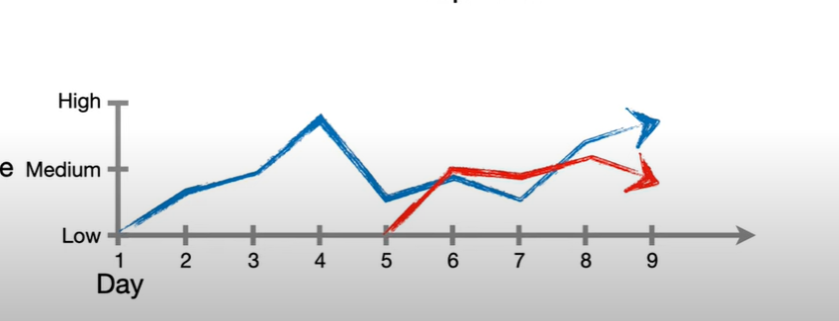
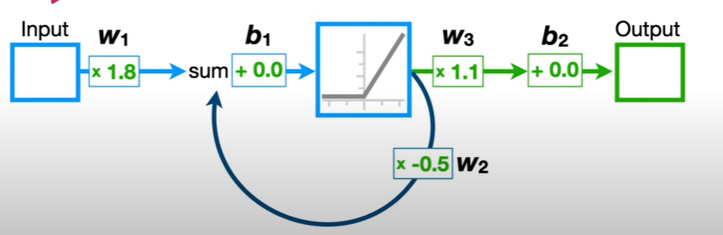
What is RNN?
Let’s take an example of stock
market prediction
Basic Structure of RNN

Slide 3
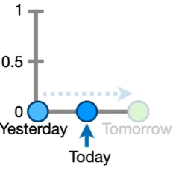
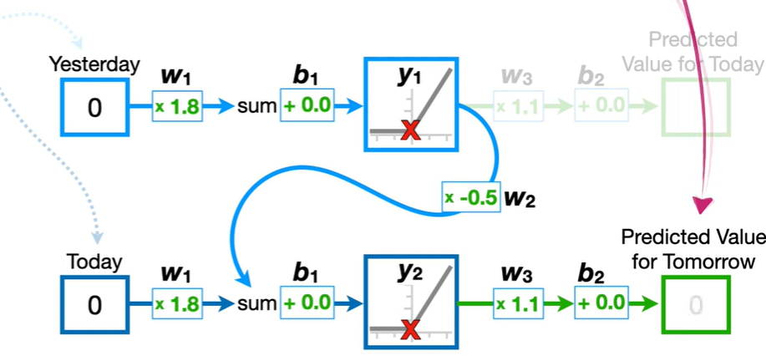
Working of RNN
EQUATIONS:
1) y1= f(0,(Yesterday_val * w1 + b1))
2) Feedback_loop = y1* w2+ b1
3) y2= f(0,(Todays_val * w1 + b1 * feedback_loop))
Predicted_val= y2* w3 + b2

Slide 4
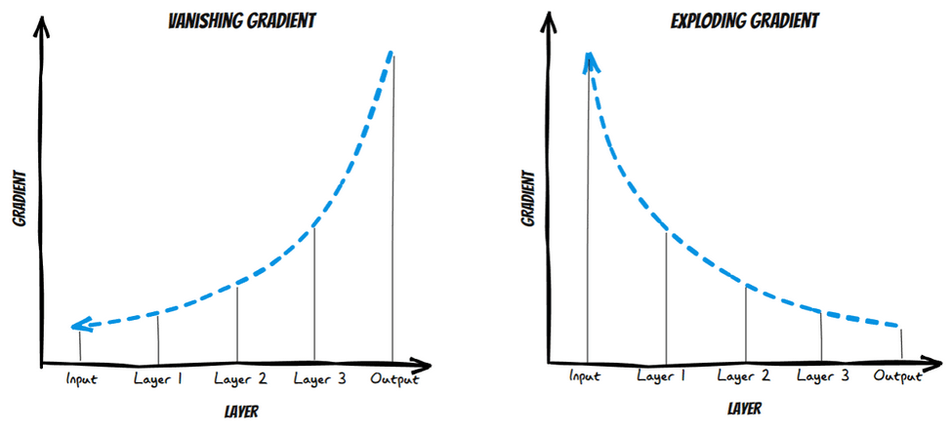
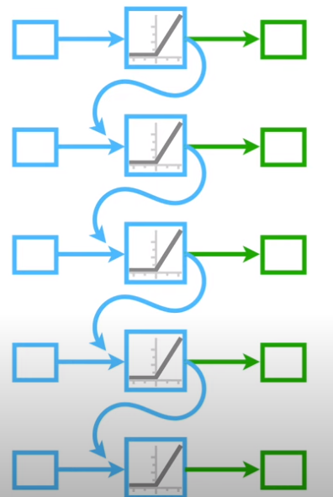
Challenges of RNN
Challenge 1 : Harder to train
Challenge 2: Vanishing Gradient
Challenge 3: Exploding Gradient
The more we unroll, the harder it is to train

Slide 5
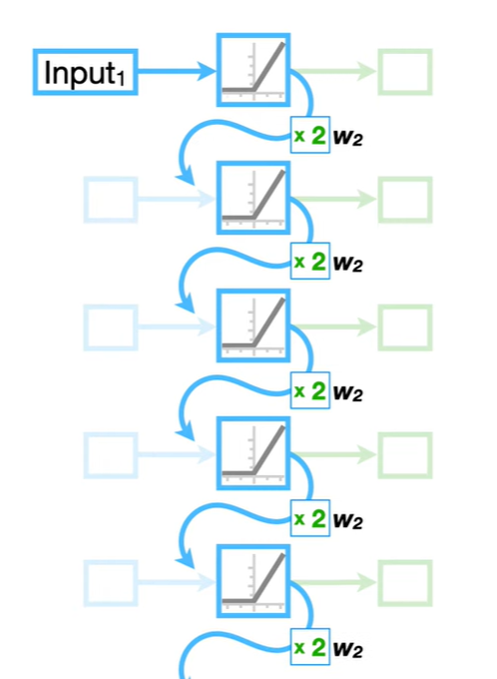
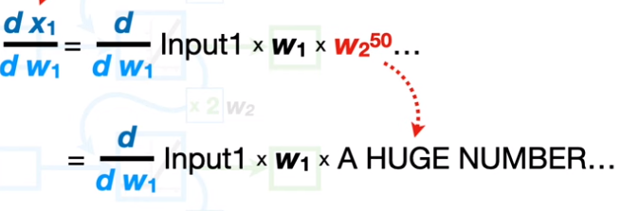
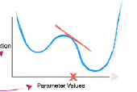
Exploding Gradient
Lets say, w2 = 2 & we have 50 input past value.
Therefore, Input1 * (2 ^ No of time unroll)
Input1 * (2^50) i.e Input1 * A huge Number
Loss function
Parameter value

Slide 6
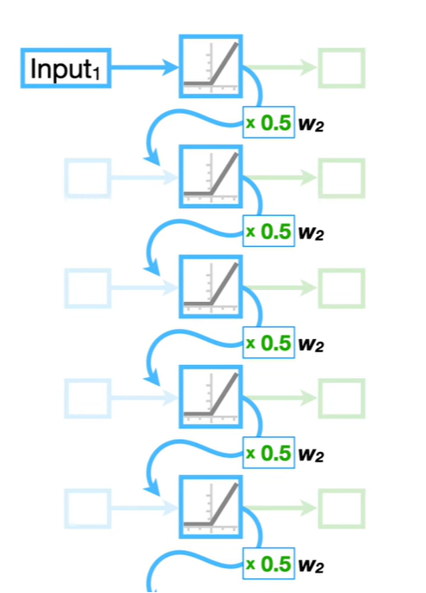
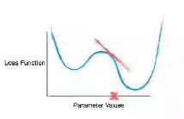
Vanishing Gradient
Lets say, w2 = 0.5 & we have 50 input past value.
Therefore, Input1 * (0.5 ^ No of time unroll)
Input1 * (0.5^50) i.e Input1 * Num close 0
Loss function
Parameter value

Slide 7

How to solve the problem?

Slide 8
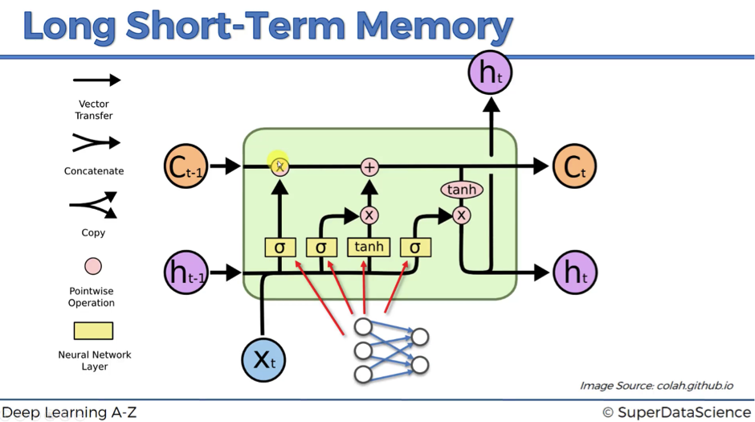
Long Short Term Memory

Slide 9
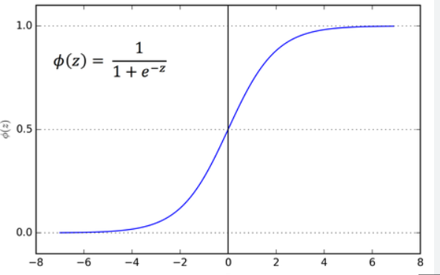
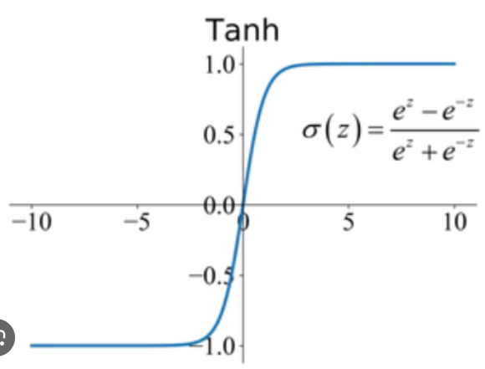
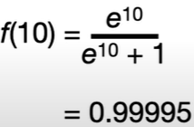
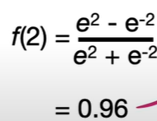
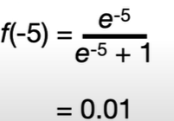
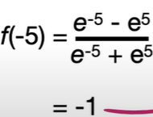
Sigmoid
Tan h
It converts any x value into y coordinate between 0 & 1
It converts any x value into y coordinate between -1 & 1
Company

Slide 10
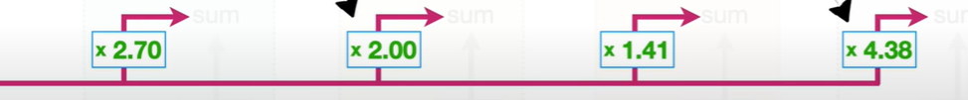
Working
1.Green line is called the cell state and represents long term memory
2. It can be modified using mul and summation,
3. No weights and biases: as it allows it to unroll units without causing vanishing or exploding gradient
Pink line represents the short term memory
Connected to weights that can modify them

Slide 11
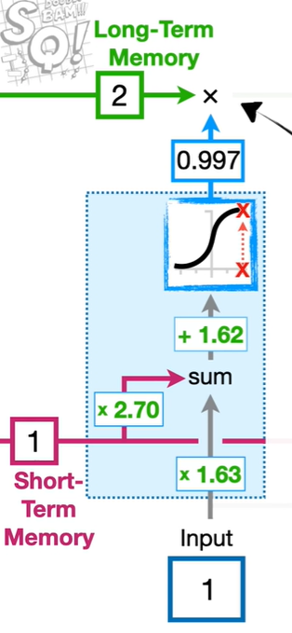
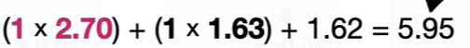
Forget Gate
1.99
If the input is 1, then the output would have been 1.99, that means 1.99 percent of the memory is retained
If the input is -10, then the output would have been 0 that means 0 percent of the memory is retained, its forgotten!!

Slide 12
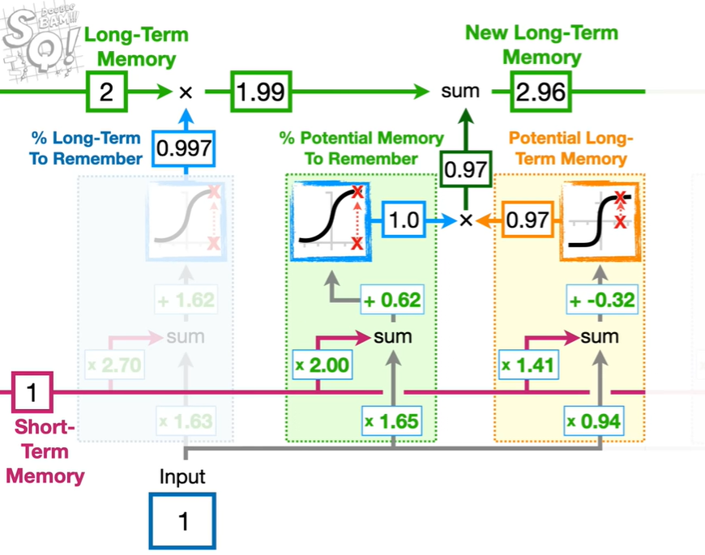
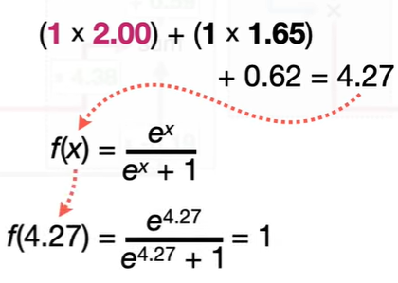
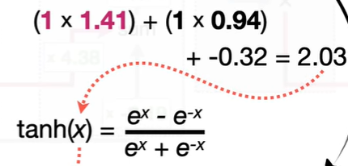
Input Gate
Left block calculations
Right block calculations
= 0.97

Slide 13
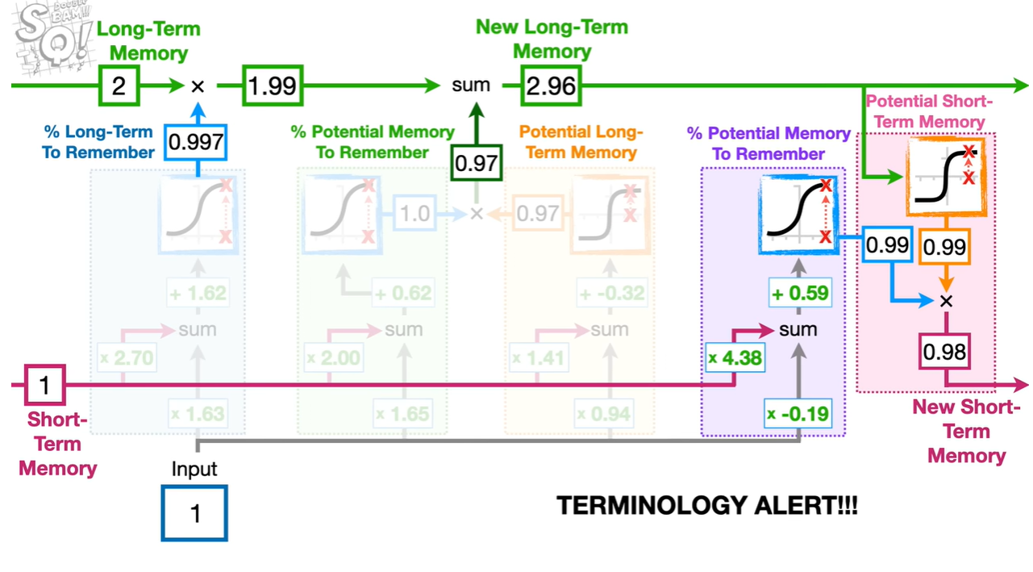
Output Gate
Responsible for potential short term memory!!

Slide 14
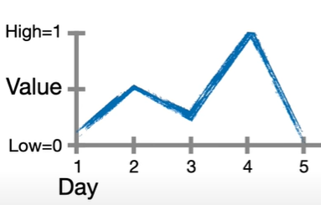
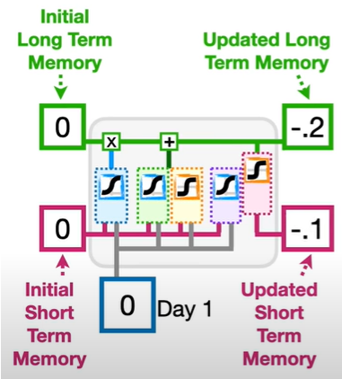
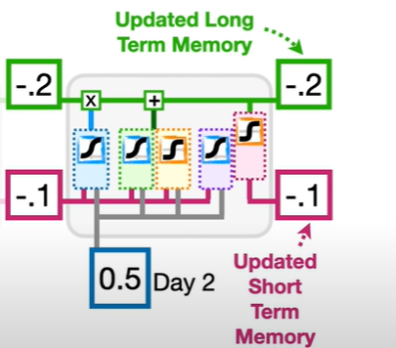
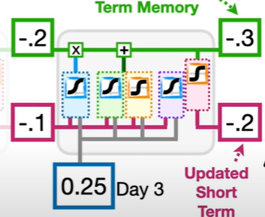
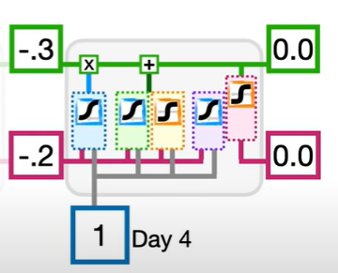

Slide 15
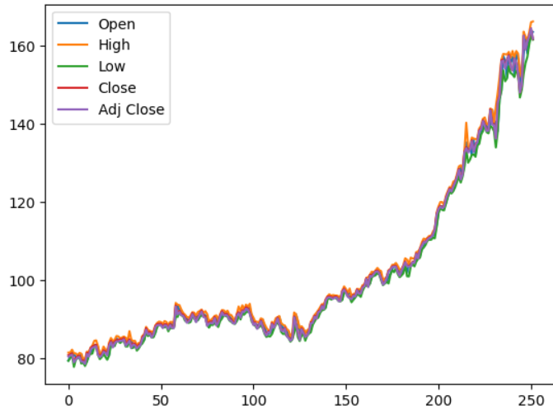
General Electric Company (GE) The dataset from yahoo finance captures General Electric Company's historical prices. It includes daily records of the opening, highest, lowest, and closing stock prices along with the adjusted closing prices

Slide 16
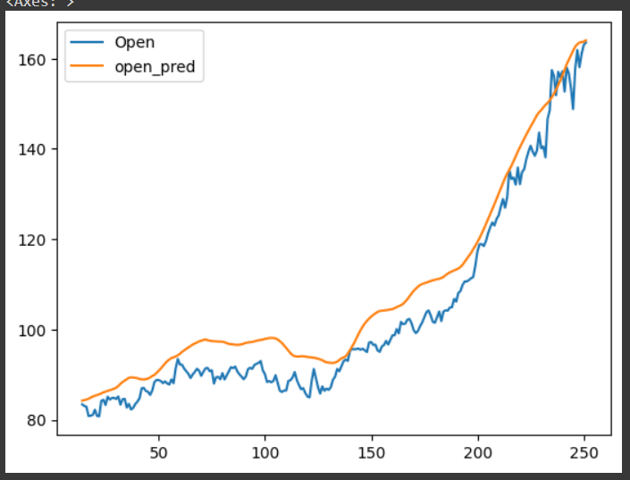
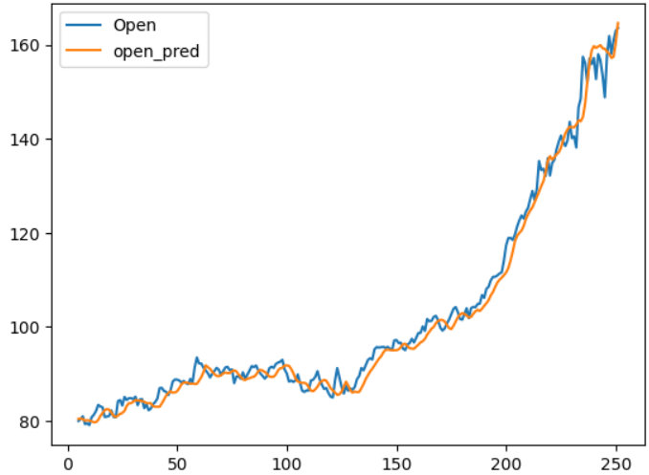
LSTM
Window size = 14
LSTM
Window size = 5
Accuracy : 92.03
Test RMSE: 0.06
Accuracy : 98.6
Test RMSE: 0.02

Slide 17
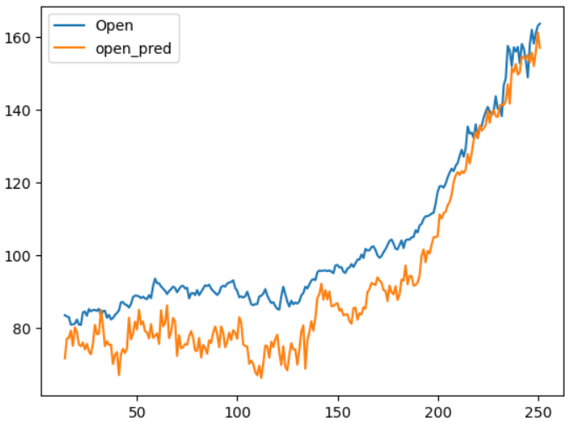
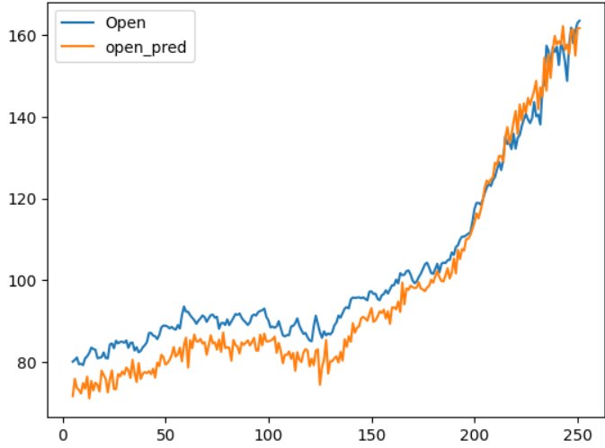
RNN
Window size = 14
RNN
Window size = 5
Accuracy : 73.03
Test RMSE: 0.13
Accuracy : 91.8
Test RMSE: 0.07

Slide 18
OBSERVATIONS
1. Model Sensitivity to Window Size: The LSTM model shows relatively high robustness to an increase in window size (from 5 to 14 days), with only a modest decrease in accuracy from 97% to 92%. This suggests that LSTM can capture the dependencies over longer sequences better than the RNN. Where as, the RNN's accuracy drops significantly from 95% to 73% when increasing the window size, indicating it struggles with longer dependency contexts.
2. LSTM's Superiority in Capturing Long-Term Dependencies: LSTM's design allows it to remember information for longer periods, which is likely why it outperforms RNN with the larger window size. This capability is crucial for time series forecasting where past information is often strongly indicative of future trends.
3. Implications for Model Selection and Tuning: The observations suggest that while LSTMs are generally more resource-intensive, they are more suitable for tasks requiring the modeling of longer sequences in financial time series. Meanwhile, RNNs might be preferable for quicker, less computationally expensive tasks with shorter sequence dependencies or where training data is limited.

Slide 19
THANK YOU

